Slide 1
Location Analysis for Positioning Medical Practice Greater London Area
Asanka Pannipitiya
IBM Capstone Project – April, 2020

Slide 2
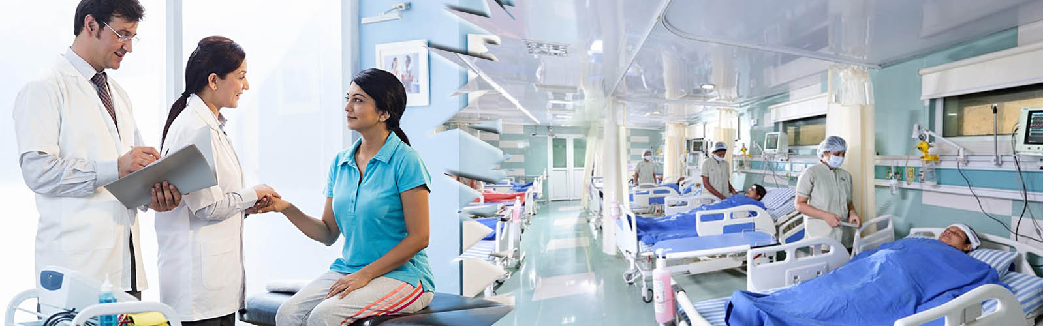
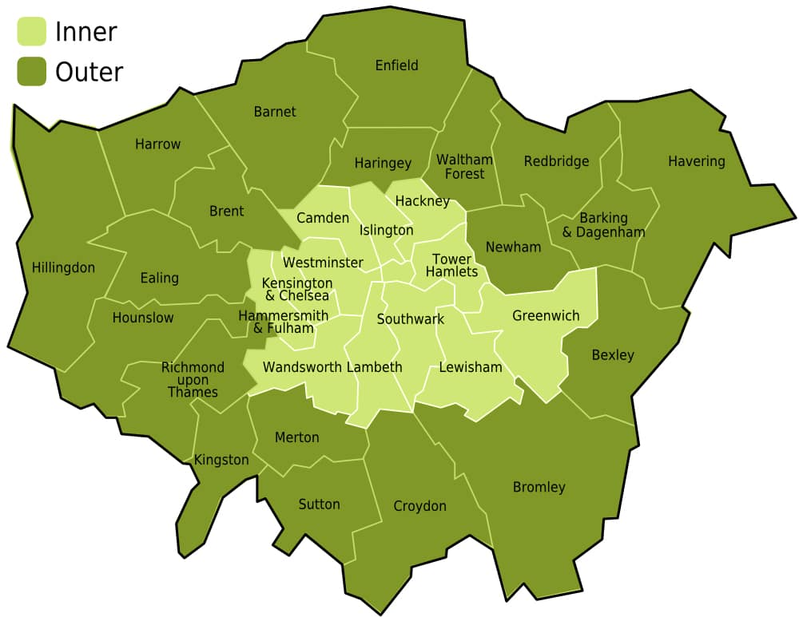
Introduction
Source: The Med Strathpine Medical Centre
The purpose of this study is to figure out suitable locations out of 625 local wards in Greater London area.

Slide 3
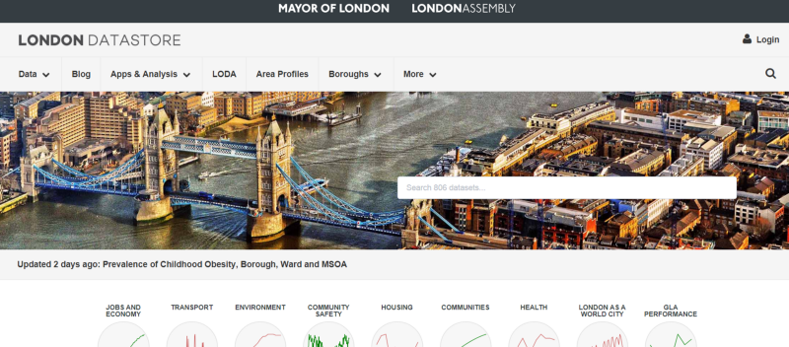
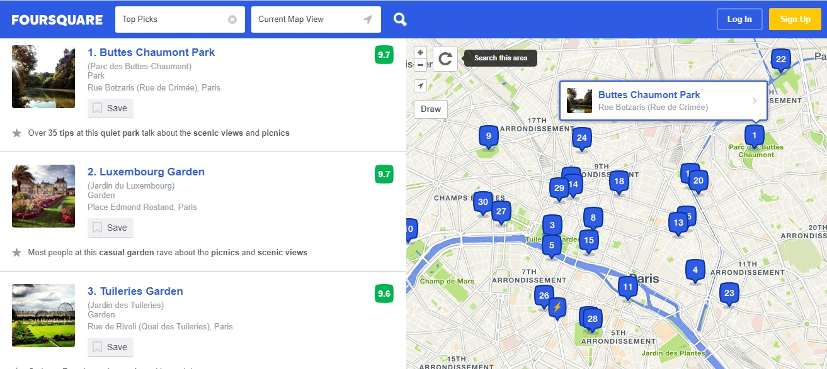
Data Gathering
Features to be used in the study:
Population Density
Population Growth Coefficient
% of old adult (65+ years)
% of children (0 – 15 years)
Existing medical centre count
Source of Data
London Datastore,
Foursquare API
https://data.london.gov.uk/dataset/land-area-and-population-density-ward-and-borough
https://data.london.gov.uk/dataset/ward-profiles-and-atlas

Slide 4
Data Cleaning and manipulation
Final data frame containing all the features is generated through the data process flow illustrate in here.

Slide 5
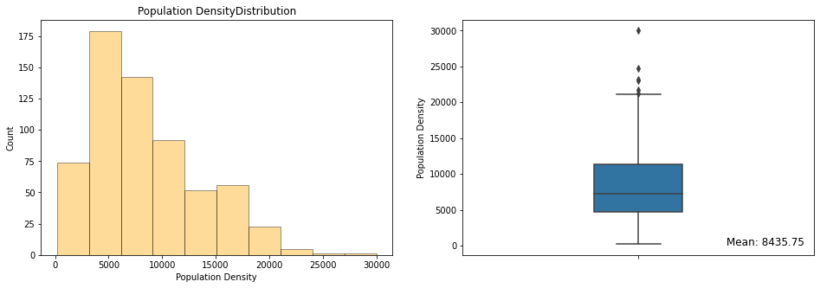
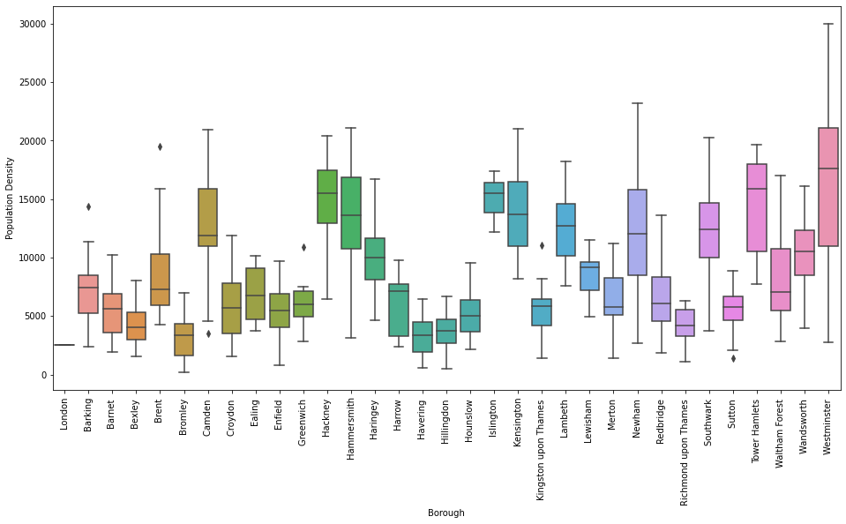
Exploratory data analysis
Population Density
Just over 51% of the wards have population density between 3000 and 9000.
Westminster borough has one local ward with the highest population density in Greater London area, 30,000 people.
Most boroughs have at least one or many wards with lower population density (< 2000 peoples/ward).

Slide 6
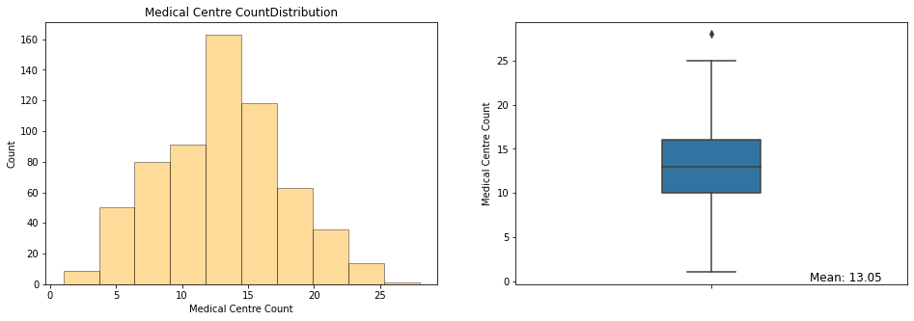
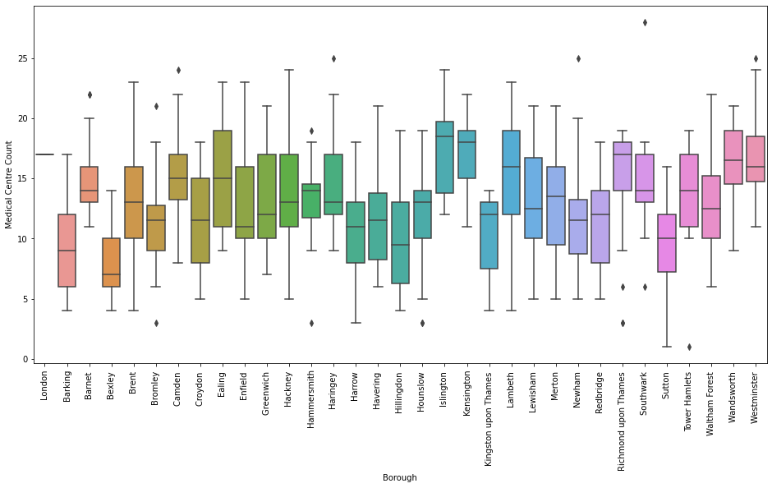
Exploratory data analysis
Medical Centre Count
Foursquare API has fetched 8,154 medical centres across 625 local wards.
There are some areas with high count of medical centres, but they don't have higher population density, and opposite is true for some localities too.

Slide 7
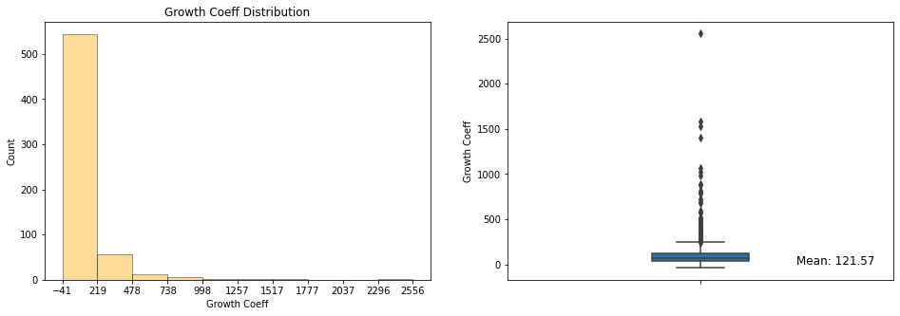
Exploratory data analysis
Growth Coefficient
Population growth coefficient is calculated using the linear regression model on our population figures for 50-years, GLA 2016-based population projections (housing-led model) for all 625 wards.
Most of the wards have population growth at the lower end of the spectrum.
There are some suburbs with negative growth coefficient.

Slide 8
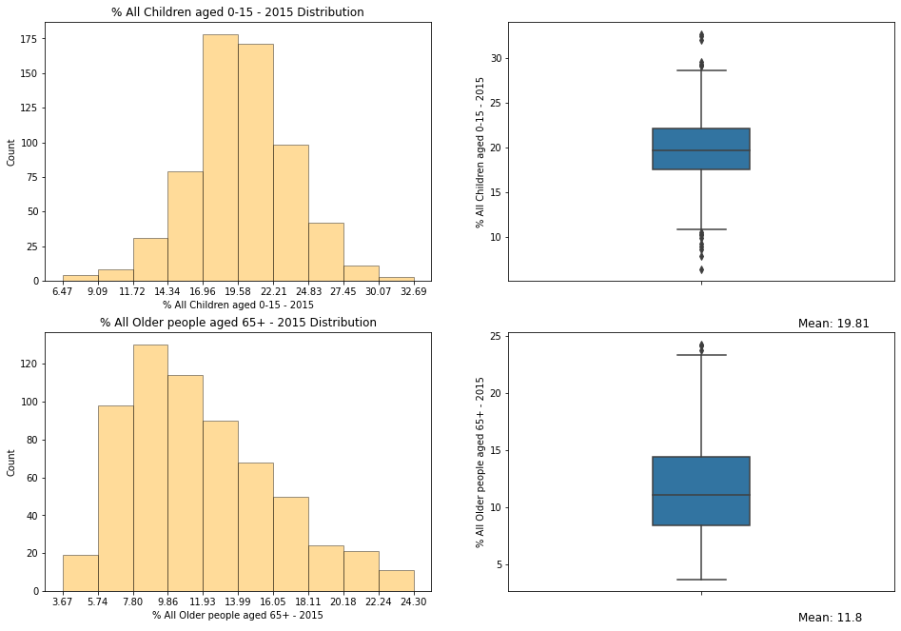
Exploratory data analysis
Percentage of all children (0-15 years) and older people (65+ years)
As can be seen from the figures, most of the wards have children percentage range from 17% to 22% and older people percentage between 5.75% - 14%.

Slide 9
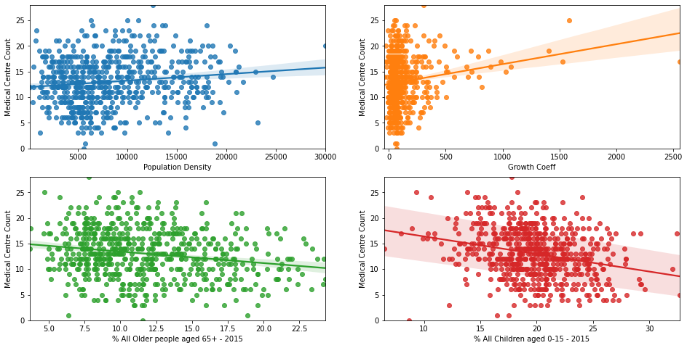
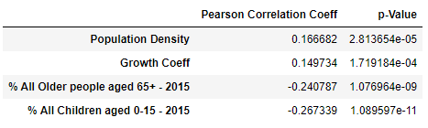
Exploratory data analysis
Correlation between Population features and existing medical centre count
Interestingly, none of the features show significant correlation to medical centre count.
In fact, children and adult population % have negative correlation coefficients.

Slide 10
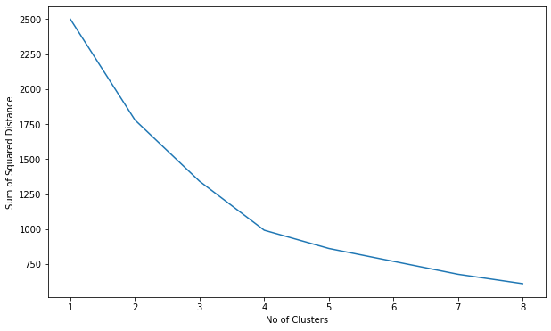
Machine learning approach
K-Means Clustering
K-means clustering applied to all 625 local wards on population features (excluding the medical centre count).
Hyper-parameter tuning (optimal K-value) by plotting sum of squared distance of samples to closest clusters.

Slide 11
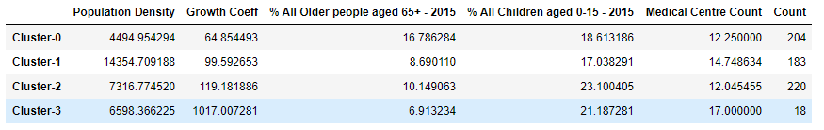
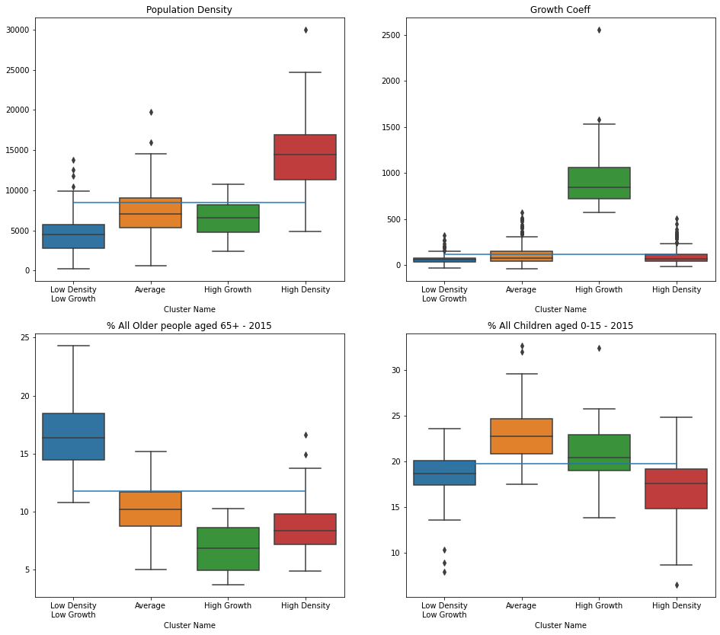
Cluster analysis
Looking at the mean values of the features within each cluster, following characteristics of the local wards being identified:
Cluster – 0 (Low-Density & Low-Growth suburbs)
Cluster – 1 (High Density suburbs)
Cluster – 2 (Average suburbs)
Cluster – 3 (High Growth/Booming suburbs)

Slide 12
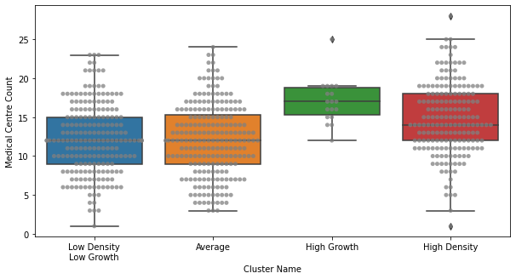
Cluster analysis
Medical Centre Count Distribution within Clusters
Each grey dot in the figure is a local ward with respective medical centre count as shown in the vertical axis.

Slide 13
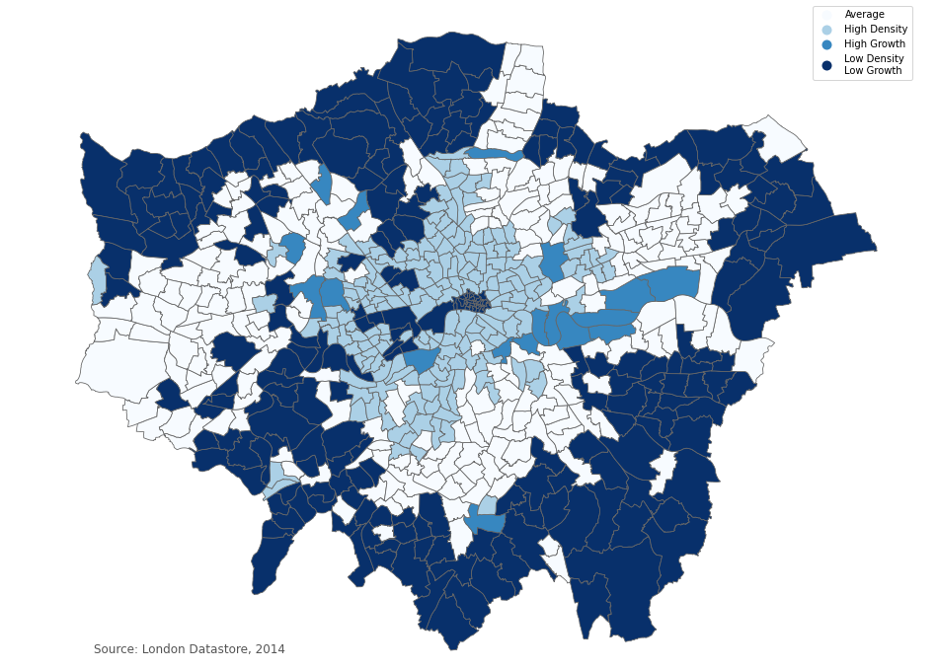
Cluster Visualization in Choropleth Map
Categorical choropleth generated through Geopandas library shows different clusters on the Grater London ward map.
Outer fringes are low-density/low-growth, which is typical characteristic of most of the metropolitan areas.

Slide 14
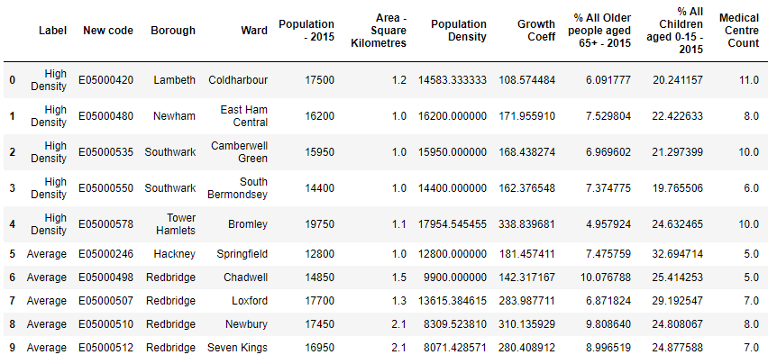
Results and Discussion
Below is the logic to further filter out the wards:
Cluster 1, 2 and 3, named Average, High-growth and High-density wards are most suitable for the purpose.
Within those clusters, wards positioned above the mean value of respective population features are considered.
Then only suburbs those having medical centre count below the 25th percentile is selected.

Slide 15
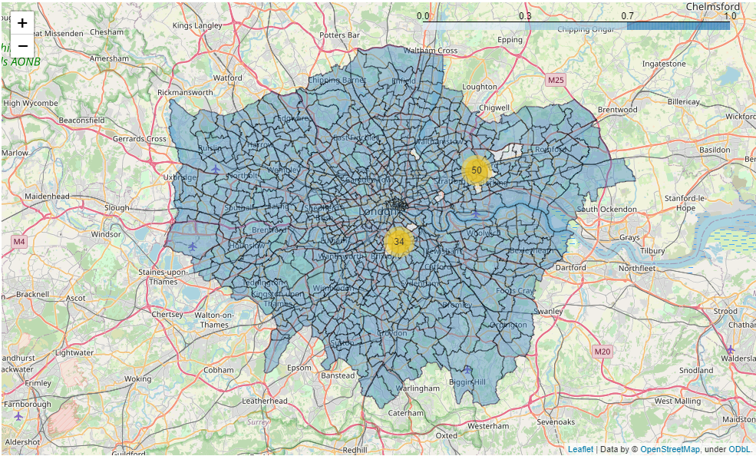
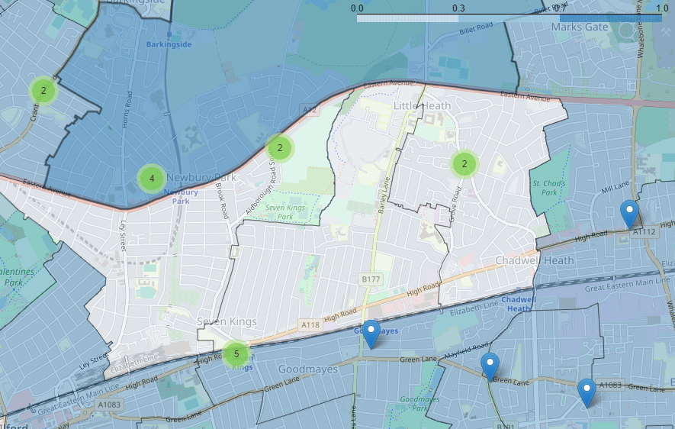
Results and Discussion
Foursquare API is again utilized to fetch medical centre details for those 10 suitable wards.
Folium map shows those centres as markers on the map.

Slide 16
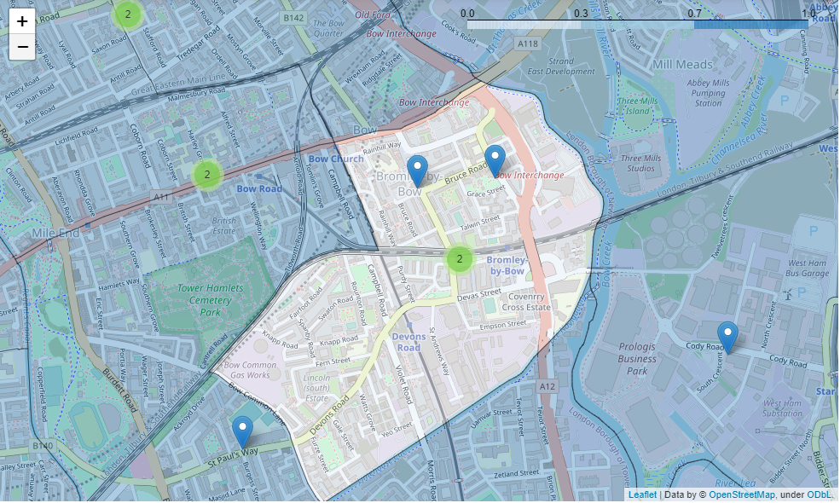
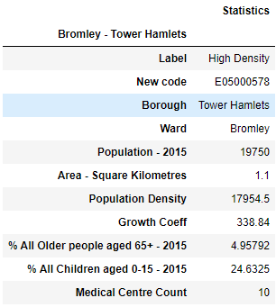
Results and Discussion
Example ward:
Bromley, Tower Hamlets
Unshaded area is the ward boundary. Markers on the map shows locations of the existing medical centres.
Encircled on the map is a possible area for a new medical centre, purely based on the unavailability of any existing centres in the close vicinity.
Possible location for a medical centre

Slide 17
conclusion
In this study, 625 local wards in Greater London area are analysed to figure out suitable neighbourhoods for positioning a new medical centre.
After looking at descriptive statistics for each population-related features, these wards are segmented into 4 different clusters using K-means clustering algorithm.
4 clusters demonstrate characteristics similar to high density, high growth, low density/growth and average suburb profiles.
By further filtering of the local wards based on existing medical centre count , 10 wards are identified as suitable in Greater London area.
Folium and Geopandas libraries in Python are used to generate choropleth maps and then used markers to show the medical centres on the map.

Slide 18
References
London Datastore, (https://data.london.gov.uk/)
Foursquare API, (https://developer.foursquare.com/)
Geopandas Library, (https://geopandas.org/mapping.html)
Folium Library, (https://python-visualization.github.io/folium/modules.html)
https://towardsdatascience.com/

